Slide 1
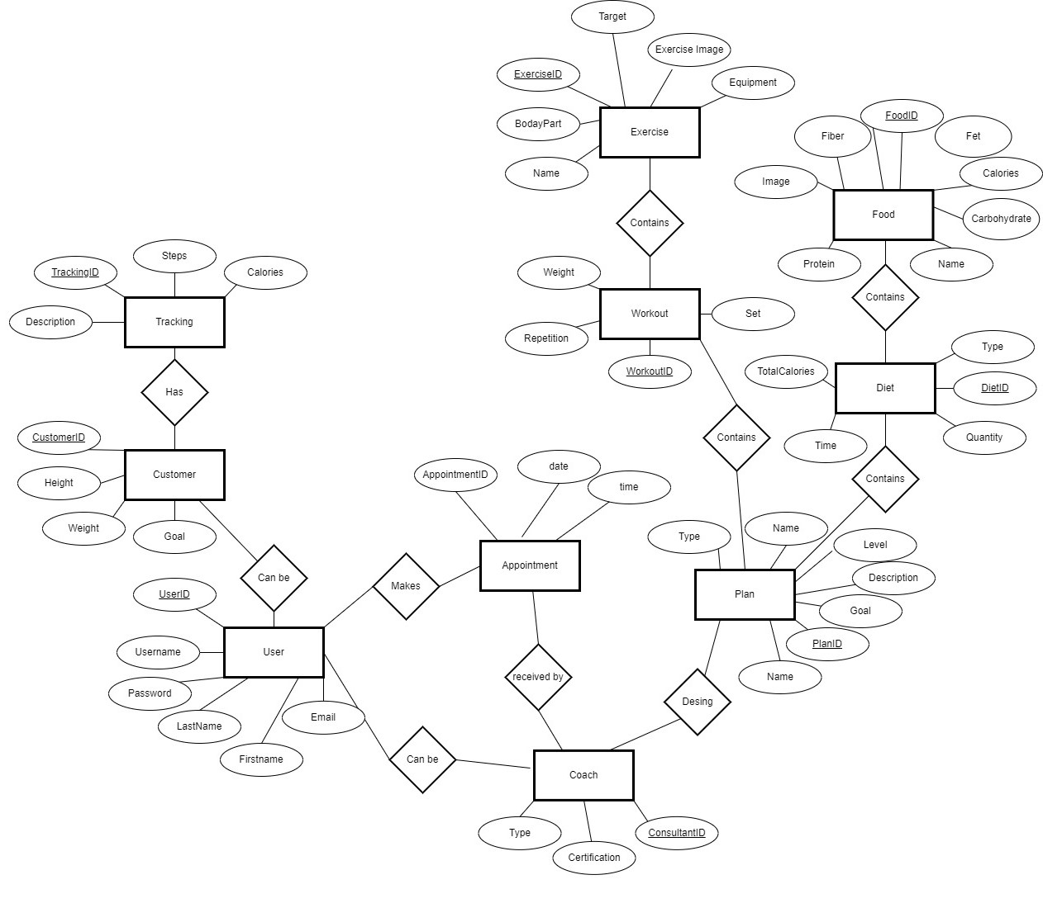
Conceptual ER Diagram I3 Scope Health Application

Slide 2
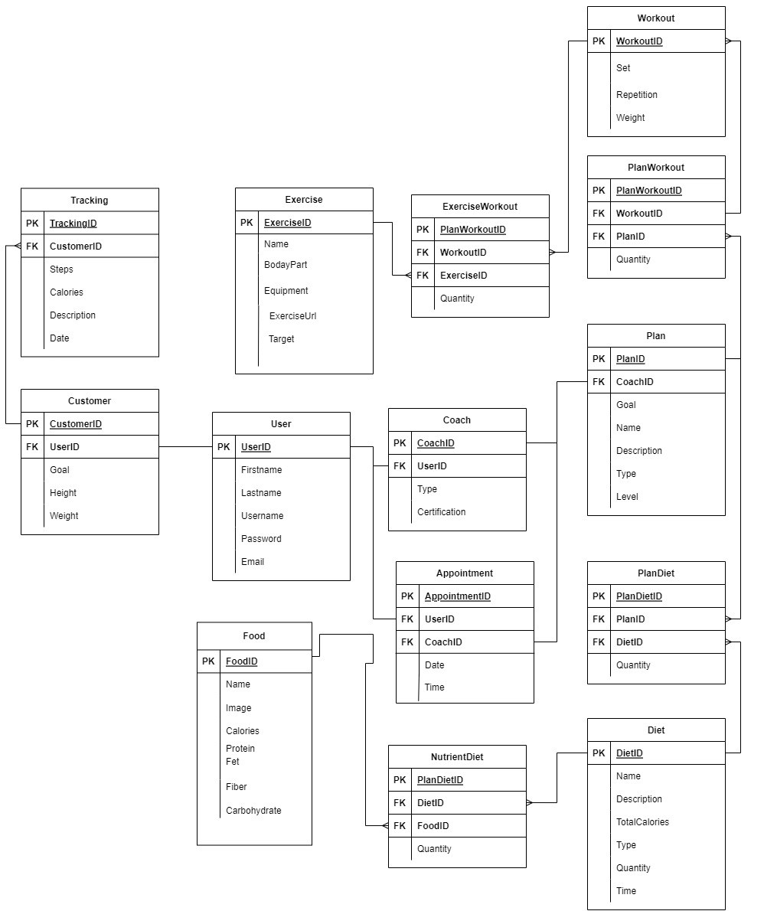
Logical ER Diagram​​– I3 Scope Health Application

Slide 3
Revision Notes
We just add appointment table and its properties.

